Slide 1
How can we increase revenue
from
Catch the Pink Flamingo?
Eren Berkay Ünlü
Notes:
Hello everyone, my name is Eren Berkay Ünlü. Today I will be talking about my data analysis from Catch the Pink Flamingo game. Also based on the analysis, how can we increase the revenue from this game.

Slide 2
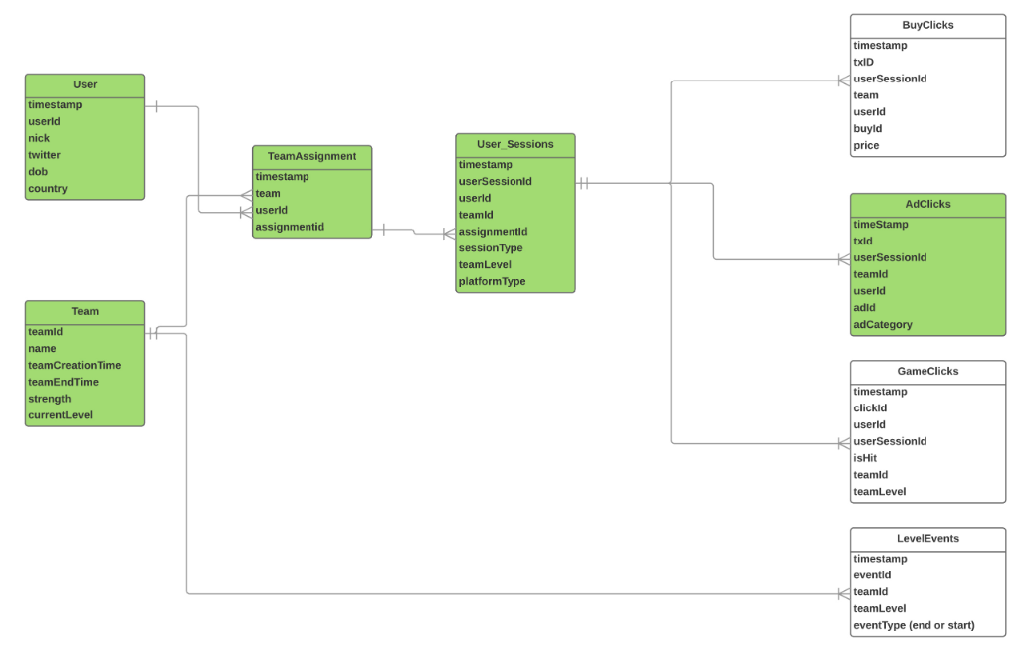
Problem Statement
How can we use the following data sets to understand options for increasing revenue from game players?
Notes:
How can we use the following data sets to understand options for increasing revenue from game players?
This slide shows the relational schema of the data sets which can would be used for
increasing revenue.
The User data set contains the information of the users including their id’s, nicknames, countries.
The Team data set contains the details of each team consisting of id’s, names, streghts, current levels.
The Team Assignment data set on the other hand includes users assignment information to the teams.
The User Sessions data set has the information of all the user sessions. This information includes timestamp, user session id, session type, team level,
platform type.
The three data sets on the right clicks of users related to our game.
Finally, the Level Events data set consists of the information about team level events in game.
These datasets are necessary for classification, clustering and making a reasonable recommendations to increase the revenue.

Slide 3
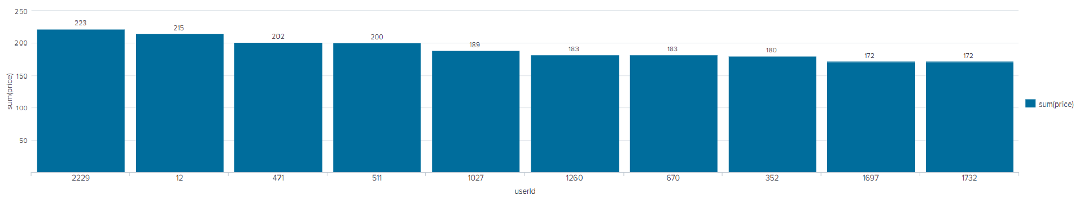
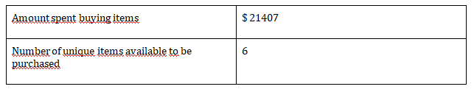
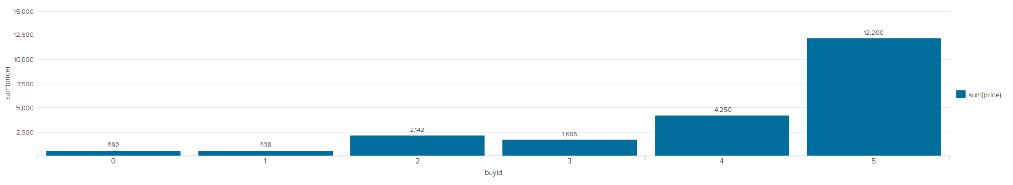
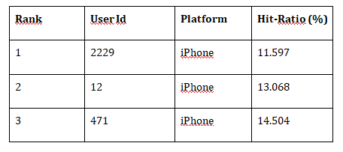
Data Exploration Overview
Notes:
Data Exploration is important. I’ve done both aggregation and filtering on all different data sets. Here are some key findings in these data. On the left figure is a histogram of how much money was made from each item. buyId represents the ID for each merchandise. You can see item 5 generates the most income. However, this is not entirely because item 5 has the most sell. It is partly due to the price of item 5 is the highest of all. On the right side figure is a histogram of total amount of money spent by the top ten spending users. This chart tells us what is the most money one user has spent on buying items in this game, and based on the user ID we can also analyze what characterics these high spending users have in common. For example, the platforms they use and the hit accuracy they have in the game

Slide 4
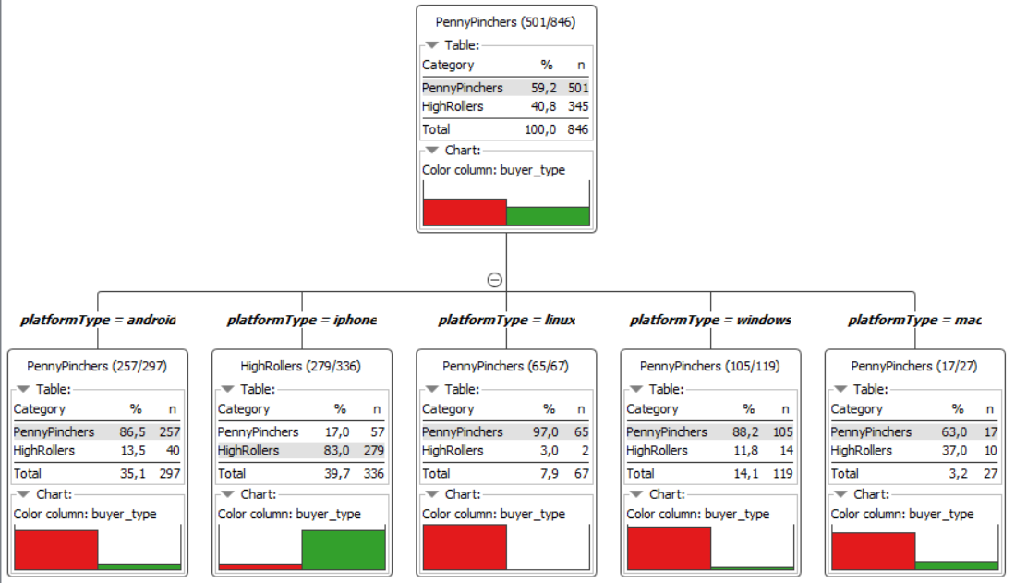
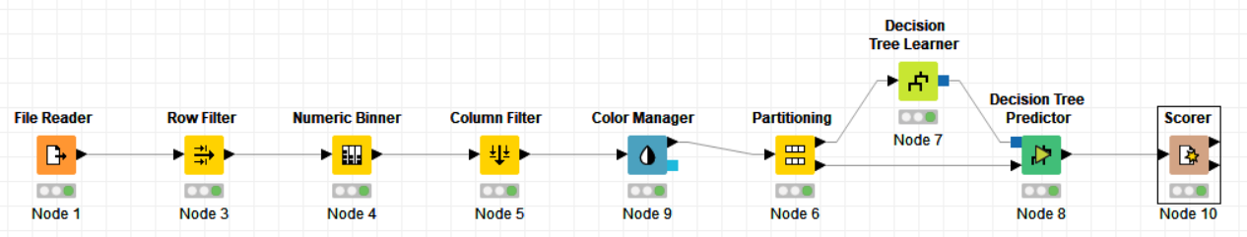
What have we learned from classification?
Notes:
I performed classification analysis using a decision tree model. First I created another categorical attribute that cdivide avg-price into 2 categories: HighRollers and PennyPinchers, where buyId greater than 5 belongs to the HighRollers and buyId lower than or equal to 5 belongs to the PennyPinchers. The creation of this new categorical attribute was necessary because it simplifies the classification of users and it is the base that we are going to use to build our decision tree. Then I discarded attributes related to unique IDs. The data was then randomly partitioned into 70% and 30% for training part and test part in our decision tree model. This is important because when we do data analysis, we should test our model on a data set that was not used to train the model. The resulting accuracy was around 88%. It shows that iPhone users are HighRollers and users with other platform types are PennyPinchers.

Slide 5
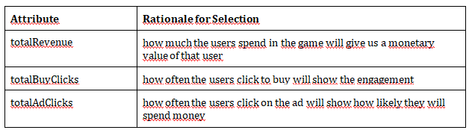
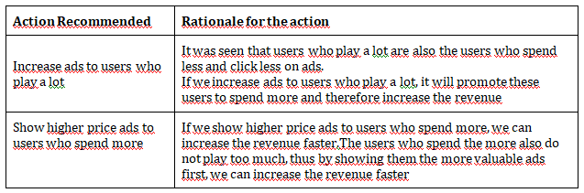
What have we learned from clustering?
Notes:
Clustering the datasets provided valuable information that users buying products of lesser range also buy lesser number of items and those buying more number of items
are those buying a wide range of items. This knowledge can be exploited to increase sales by giving customized advertisements to users. For users buying lesser variety
of items, similar products could be advertised and to those buying wide range of products, different variety of items could be advertised. This strategy would appeal
both the groups. Further, variety of products should be increased as the users appealed by more variety are the ones who buy the maximum number of items. This
will increase the sales too.

Slide 6
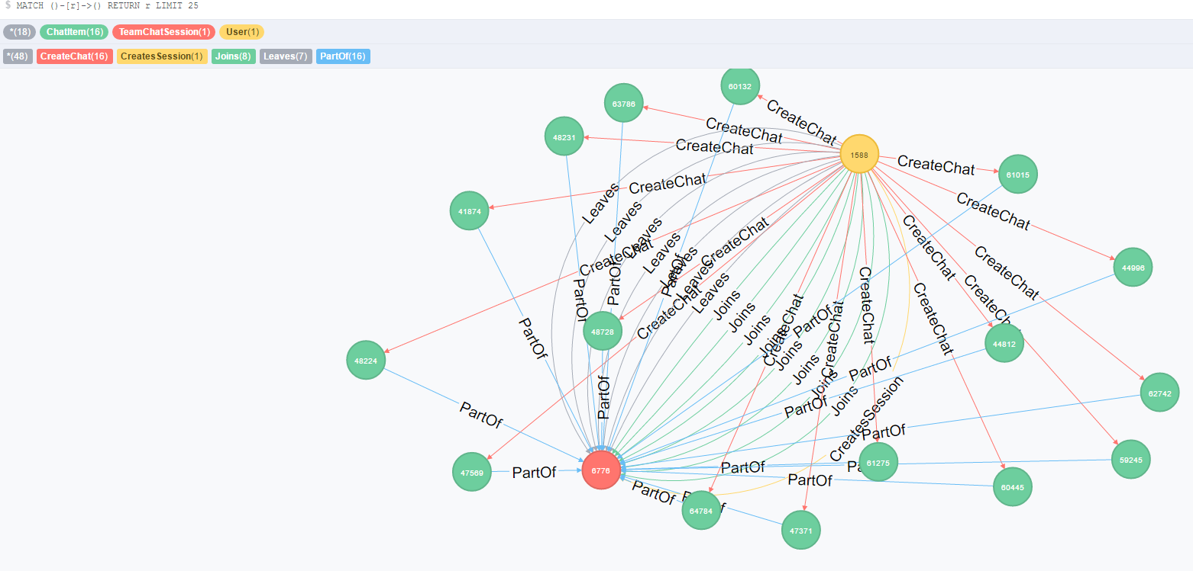
From our chat graph analysis, what further exploration should we undertake?
Notes:
From my Neo4j chat graph analysis, I found the longest conversation chain to have a length of 10. Furthermore, there are 5 unique users in this chain of conversation. This kind of search is useful for Eglence because it can tell them what kind of subjects or topics users are enthusiastic about and they can therefore set business plan targeting on these subjects. I also analyzed the relationship between the top 10 chattiest users and the top 10 chattiest teams to see if any of the user is in one of the teams. There is only one chattiest user who also belongs to the chattiest team. It seems that there is no strong relationship between chattiest users and chattiest teams. This analysis is also important as to knowing if Eglence should target more on teams or individuals. Finally, I collected information of the 3 most active users based on cluster coefficient. This kind of analysis is very useful for Eglence to target specific users.

Slide 7
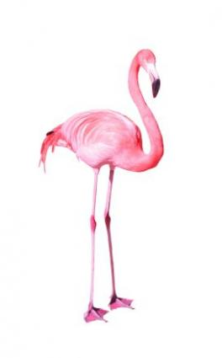
Recommendation
- Increase in-app ads or increase the price for ads in lower-level games
- Promoting the game to attract more iOS users
- Improve the quality of in game ads to attacts more clicks because most of the spending users click ads frequently
Notes:
Finally based on my analysis my recommendations in order to increase revenue are:
- Increase in-app ads or increase the price for ads in lower-level games since according to my analysis, users who achieve higher levels tend to spend less on in-app purchases
- Promoting the game to attract more iOS users.
- Improve the quality of in game ads to attacts more clicks because most of the spending users click ads frequently.

Slide 8
T h a n k Y o u F o r Y o u r
A t t e n t i o n
Notes:
That’s all for my data analysis on Catch the Pink Flamingo. Thank you for your attention.

